Slide 1

Happiness – Alcohol Data Set- Exploration
By:
Akhila m
Sree kavya durbaka
Swati Jadeja
Suparna s

Slide 2
Why This DATA SET?
Hoping to understand the relationship between alcohol consumption and happiness across regions.
Data set is covering information about HDI etc., along with Happiness Score and per capita alcohol consumption.
So, it will give interesting insights into alcohol consumption across different countries as per their development status.
We assume developed countries might have a high per capita alcohol consumption, as well as happiness.
Let’s find out who is happier!

Slide 3
How happy is our world ?
The average happiness score that we get is 5.62. On a scale of 3-8,
It is just a moderately happy world.

Slide 4
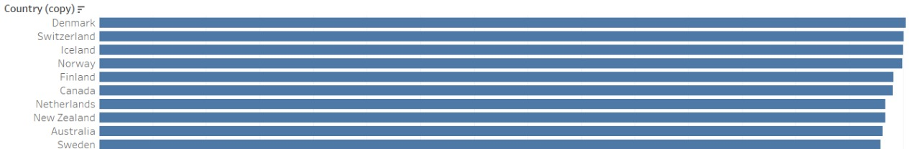
Now that we know, we live in a moderately happy world let’s find out who are the happiest countries ?

Slide 5
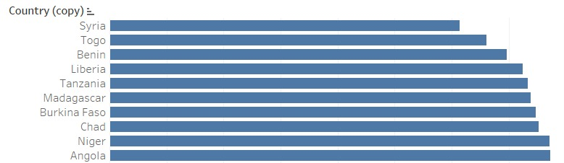
The sad countries are…

Slide 6
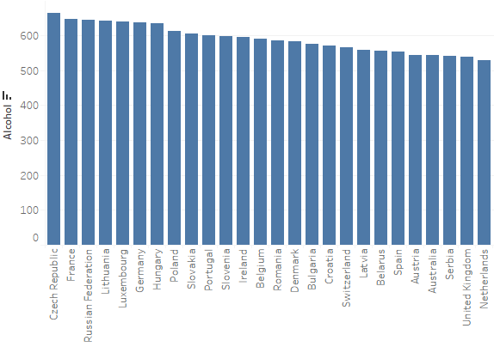
Which country drinks a lot?
Czech Republic
France
Russian Federation
Lithuania
Germany
Hungary

Slide 7
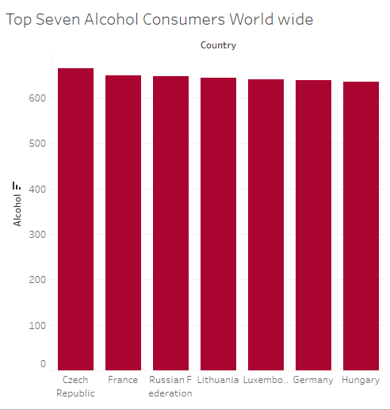
How happy are they?
Country | Happiness Ranking
Luxembourg | 14
Germany | 17
Czech | 20
France | 24
Lithuania | 41
Hungary | 60
Russian Fed | 68

Slide 8

Does high hdi mean higher alcohol consumption ?

Slide 9
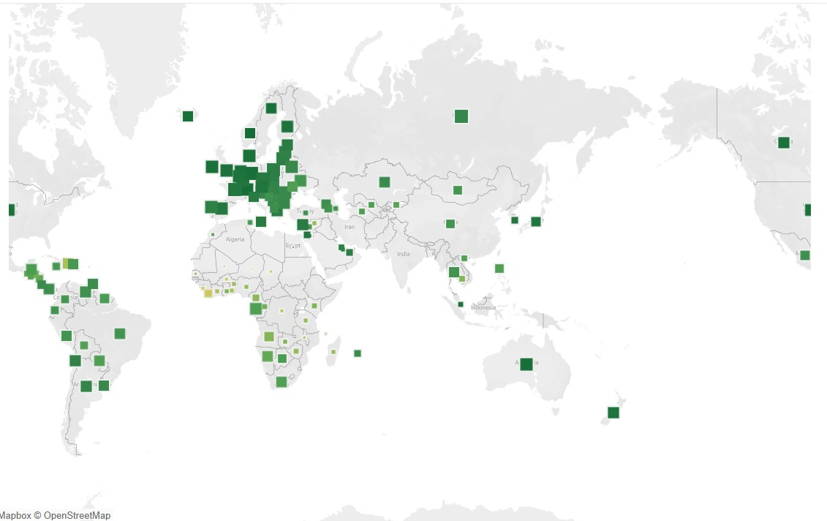
Is this assumption true ?

Slide 10

Are happy countries high on alcohol ?

Slide 11
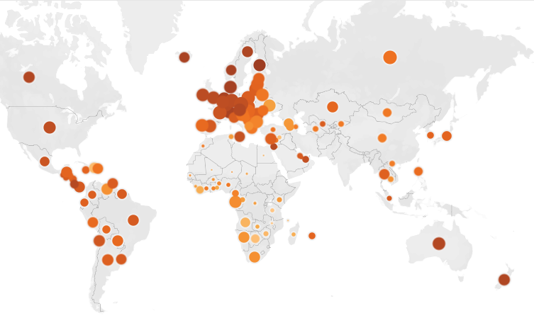
Is this assumption true ?

Slide 12
Inference
Some of the happiest countries only have moderate alcohol consumption while some sad countries have an alcohol consumption matching the European region which has the highest consumption levels.
We don’t find any significant relationship between alcohol consumption and happiness
HDI and alcohol consumption also doesn’t follow a linear pattern.
To conclude we would say that, alcohol consumption alone, doesn’t significantly impact happiness. There must be many factors in play apart from alcohol.

Slide 13
THANK you!

